Slide 1

Winning in Search Harnessing Reviews to Improve Search Results Across Organic & Paid November 12th, 2014
0
Confidential and Proprietary. © 2013 Bazaarvoice, Inc.

Slide 2
Top (3) take-aways…
When you leave here you will be able to…
Recognize the areas on a Search Engine Results Page (SERP) where BV SEO is most impactful.
Describe the SEO benefits of having Ratings and Reviews on a product detail page.
Identify the type of client that is most suited for any and / or all of the following:
Google Seller Ratings,
Google Shopping, and
Google Product Listing Ads.

Slide 3
Topics
The Importance of Search
Search Terminology
Impact of Reviews
What Components Apply to What Customers
What to Ask & What to Do

Slide 4
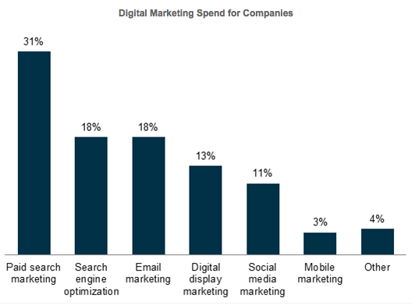
Search is HUGELY important to our clients
$22B
spent on paid Search in 2014
eMarketer Study
SEM
SEO
Source: 2013 eConsultancy/SEMPO Study

Slide 5
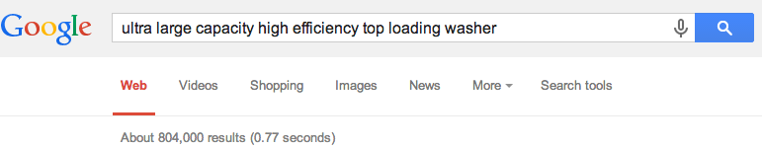
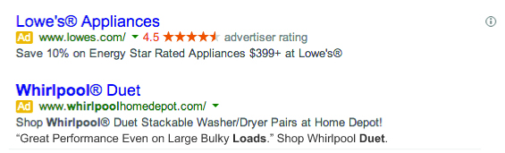
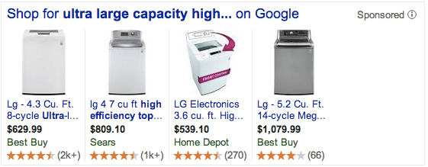
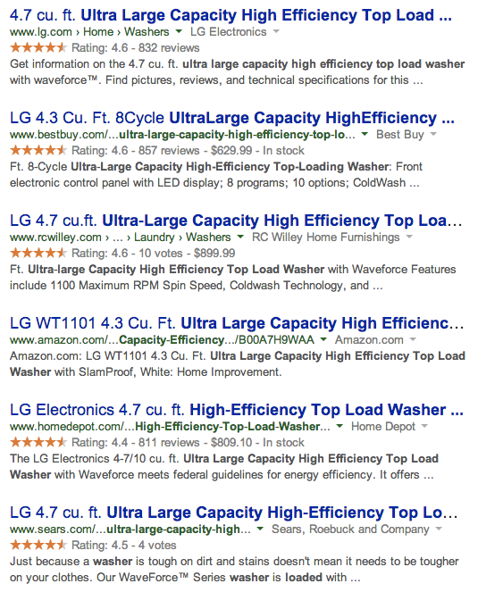
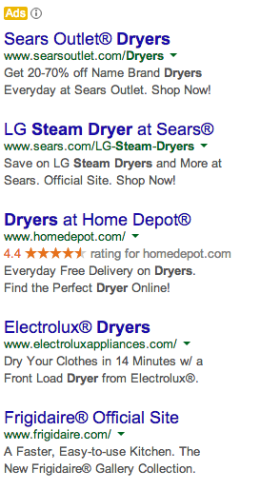
Typical Search Engine Result Page
(SERP)

Slide 6
Keywords
Improve performance for greater variety of keywords
Shopping / PLAs drove 20% of traffic for e-comm sites during Thanksgiving weekend 2013.
CPC Strategy
Product Ratings in Shopping
Google Seller Ratings
up to 17% CTR lift
Product Ratings in PLAs
Up to 11.6% CTR lift
Paid Search Ads
Product Listing Ads
Rich Snippet Stars yield
7-79% lift in CTR likelihood
Fresh Unique Content Improves Ranking. Up to 15-28% Search Lift to PDP.
Organic Search Results
Paid Search Ads
See speaker notes for sources
Notes:
Sources
Keywords – 15% of searches have never been seen before by Google. Supports long tail claim. http://www.thinkwithgoogle.com/articles/how-advertisers-are-using-search-for-brand-building.html
GSR 17% lift - http://adwords.blogspot.com/2011/04/5-simple-ways-to-improve-your-adwords.html
Rich Snippet Stars 7-79% lift in intent to click in organic – results from Bazaarvoice study: July 2014 survey results from 400 consumers around the world, showing them various SERP page scenarios with and without rich snippet stars and asking which link, if any, they were most likely to click (results to be published in a future blog)
15-28% lift in organic search traffic to PDP – compilation of BV case studies (see salesforce); using results from sites which were already optimized (the 163%, 200%, etc. lift from some case studies were from non-optimized sites and the numbers sound too big to be true)
Product Ratings in PLA 11.6% lift in intent to click– results from Bazaarvoice study: July 2014 survey results from 400 consumers around the world, showing them various PLA scenarios with and without rich snippet stars and asking which link, if any, they were most likely to click

Slide 7
Platform/Country Availability
And Client Applicability
 | Applies to Clients… | United States |  | EMEA
 |  | Conversations | PRR | Conversations | PRR
SEO | If on supported e-comm platforms | ✔ | ✔ | ✔ | ✔
GSR | E-comm clients who buy AdWords | ✔ | LA – full GA – 2/28/15 | ✔ UK, DE, FR, NL | TBD
Shopping / Product Listing Ads | E-commerce clients (retailers and D2C brands who are in Shopping or buy PLAs) | ✔ | ✔ | ✔ Shopping | ✔ Shopping
 |  |  |  | Google has not yet rolled out PLAs

Slide 8
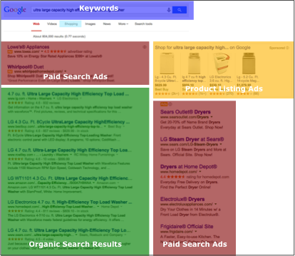
Details
We should NOT recommend Shopping or PLAs, just like we don’t recommend coupons or TV Ads. But if a client is investing in them, they should include reviews.
Client fills out this BV form to request reviews from BV (form and feed cover both Shopping & PLA)
Google Requirements:
Must be e-commerce and have 3,000+ reviews (Google can grant exceptions)
Must have valid product page URLs
Google says >30 reviews from last 12 months and 3.5 stars needed to display (may change)
Google may aggregate ratings from multiple providers (Bizrate, BV, Viewpoints, TrustedPilot, etc.)
Requires 2nd email (but consumers used to this…Bizrate collects 26M reviews a year)
In the last couple weeks Google began crawling javascript and review content from clients without BV SEO is appearing.
At this time we still recommend BV SEO

Slide 9
Where To Go For Help
Sales – Solution Architects
Client Success – TAMs
Backup and experts by product:
SEO – Michael De Haven
GSR – Jamieson Brettle
Shopping/PLA Syndication – Michael Polishook

Slide 10
Additional Resources
Google Seller Ratings content pack on Salesforce – link
Michael DeHaven’s SEO Strategy Presentation – link – mix of 101 & 201 level SEO material
Case studies – Friskies (Purina/Nestle), Swanson, Evans Cycle, Cabelas, Dillards and Skechers are all available on SFDC.
Google Shopping BV Overview
E-commerce platforms that support BVSEO – link (check with Solution Architect if in doubt)

Slide 11
Top (3) take-aways…
You should now be able to…
Recognize the areas on a Search Engine Results Page (SERP) where BV SEO is most impactful.
Describe the SEO benefits of having Ratings and Reviews on a product detail page.
Identify the type of client that is most suited for any and / or all of the following:
Google Seller Ratings,
Google Shopping, and
Google Product Listing Ads.

Slide 12
Appendix

Slide 13
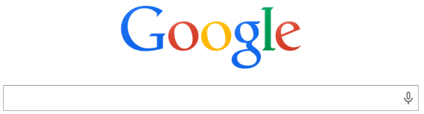
…Because Search is HUGELY important to Shoppers
89%
of consumers use Search to make purchasing decisions
Fleishman-Hillard Study
#1
in-store resource to help research products
Google Study

Slide 14
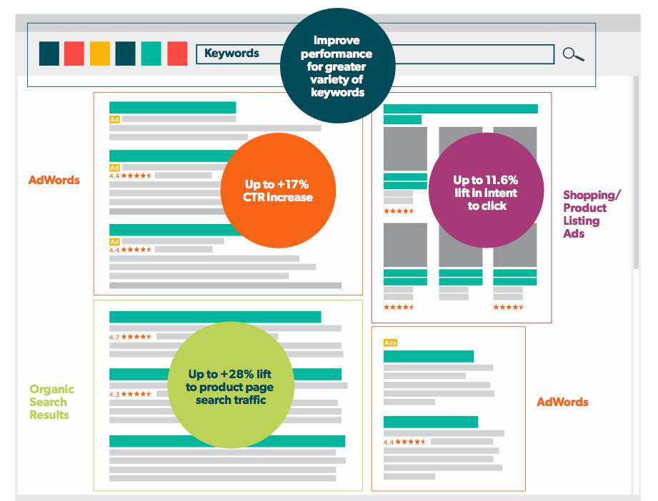
Reviews Send a Powerful Trust Signal Across the SERP

Slide 15
What is the impact?

Slide 16





Overall Impact of BV & UGC on Organic Search
SEO
1
Organic search traffic to pages where BVSEO is deployed is driven by the 3 primary factors:
Keyword performance
Position rank within the search results (which is driven by freshness of content, etc.)
Rich snippet stars
Clients that have measured improvement in product page traffic from SEO have reported a 15-200% lift.
Over 18M product pages with BV UGC have been indexed by Google.
28% increase in traffic
(site was optimized before adding UGC)
200% increase in traffic
(site was not optimized before adding UGC)
163% increase in traffic
(site was not optimized before adding UGC)
23% increase in traffic
(site was optimized before adding UGC)
Improvement in search rankings for key products & large traffic lift
Improvement in search rankings for key products
(Case studies available for each of the above)
Notes:
Keyword performance = keyword breadth, density, etc.
15-28% is a realistic target for lift to product page traffic from organic search (not overall site traffic lift or lift to all organic site wide traffic). The 163%, 200%, etc. lift figures are from sites with little to no SEO optimization and those figures may lack credibility to a client with a highly optimized site…it is OK to mention them but just be aware of why those were so high.

Slide 17
Improving Organic Search Rankings
SEO
2
Importance of Rank in Search Results Page
Incremental improvements in search rank for given keywords drives incremental traffic
+54% traffic growth expected if improving from position 3 to 2 for a given keyword
+33% traffic growth expected if improving from position 5 to 4 for a given keyword
+13% traffic growth expected if improving from position 8 to 7 for a given keyword
Source: Chitika study
Notes:
How to interpret chart: Y axis is NOT click through rate (Google doesn’t release that data) but it is a proxy. It shows the % of Google search traffic to a given page that comes from each search rank position. E.g., 33% of all Google search traffic to page X came from links that were in position 1. 17% came from links in position 2. The higher the rank, the greater the likelihood it’ll drive traffic.
http://chitika.com/google-positioning-value
BV Study notes: July 2014 survey results from 400 consumers around the world, showing them various SERP pages with and without stars and asking which link, if any, they were most likely to click

Slide 18
No Reviews
Reviews – Page 1
Reviews – Page 2
2
SEO
Header (~100 words)
Header (~100 words)
Header (~100 words)
Product Details
(~150 words)
Ads (nominal)
Product Details
(~150 words)
Ads (nominal)
Product Details
(~150 words)
Ads (nominal)
Reviews
(~3,000 words)
Recommendations (nominal)
Recommendations (nominal)
Recommendations (nominal)
Reviews
(~800 words)
Reviews
(~3,000 words)
Footer (~100 words)
Footer (~100 words)
Footer (~100 words)
100
100
150
350
57%
43%
Header
Footer
Product Details
Total Words
Duplicate Template Content
Static Product Content
100
100
150
+ 800
1,150
17%
13%
70%
Header
Footer
Product Details
Reviews
Total Words
Duplicate Template Content
Static Product Content
Fresh Review Content
100
100
150
+ 3,000
3,350
6%
4%
90%
Header
Footer
Product Details
Reviews
Total Words
Duplicate Template Content
Static Product Content
Fresh Review Content
Notes:
Reviews – Page 1 – Bazaarvoice loads 8 reviews because we know most people read 7 or 8 reviews, and it keeps page loads quick. This helps you win where you are competing today, i.e., driving traffic to a product detail page, by providing fresh content and lowering duplicate and static content.
Reviews – Page 2 – Bazaarvoice loads 30 reviews. We know only 5% of users click beyond the first page of reviews, but for those that do, they are doing deep research and Page 2 is therefore more likely to give them the answer. And we know 7% of search terms include “review”, so this helps you win where you are not competing today, capturing traffic for reviews keywords and long tail keywords, in addition to allowing the “deep researcher” to find their answers.

Slide 19
Keywords – Why they matter
SEO
3
The Long Tail
15% of the 100 billion monthly Google searches are completely new. Many of these are “long tail searches”.
UGC reflects the natural language, comments and concerns of consumers, and is thus well suited for capturing long tail searches.
Many of these long tail searches drive high quality traffic, as the consumers have specific needs or concerns to help guide their decision.
Marketing copy can not match the keyword breadth used by consumers.
(15% stat per Google)
Notes:
It doesn’t make sense for clients to optimize for long tail keywords because the ROI isn’t there to do it manually (by definition, each individual long tail keyword phrase will receive little traffic).
But Bazaarvoice can leverage the consumer reviews to improve long tail keyword performance and keyword performance where “reviews” are included (we know 7% of searches contain the keyword “reviews”)
Think of it as “Keyword Expansion”

Slide 20
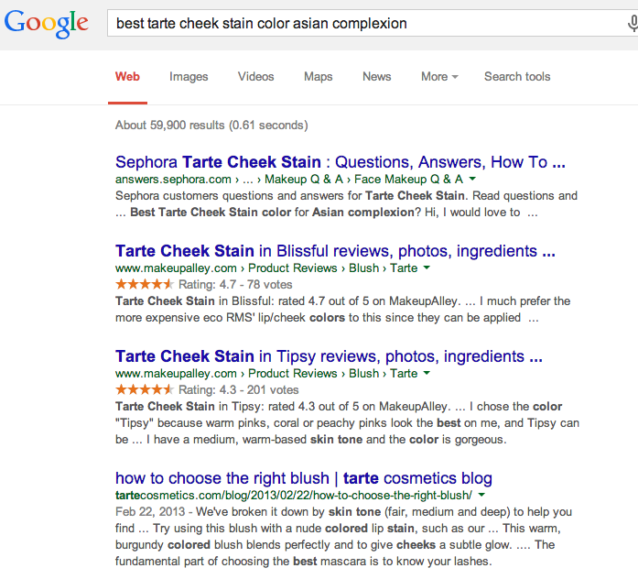
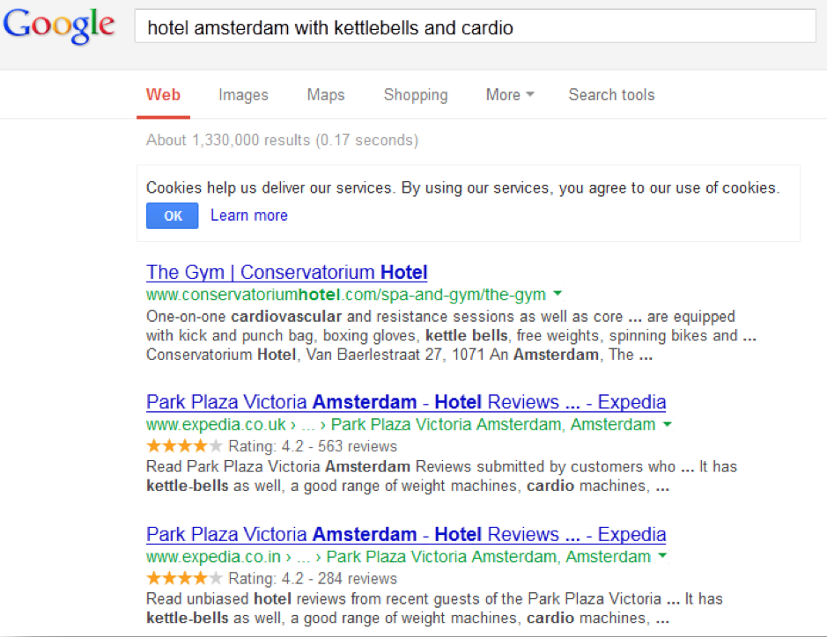
SEO
3
Keywords – Example Increase Keyword breadth to capture more long tail searches
Ratings and Reviews
Questions and Answers

Slide 21
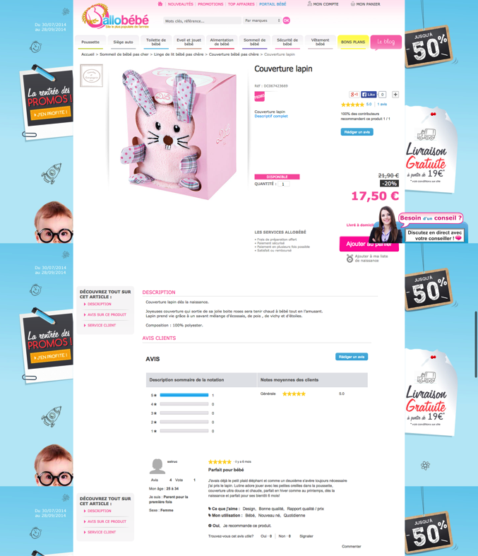


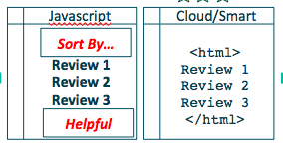
Keywords – How We Do It Search engines don’t see what users see (applies to Hosted Display)
3
SEO
Customers interact with the JavaScript content and features
The Google bot reads the same content in HTML injected via Bazaarvoice SEO
We present the same content to users and to Google, each in a format appropriate to them

Slide 22
SEO
4
Improving CTR/CTA in Google Search Results
(the famous rich snippets)
Importance of Rank in Search Results Page – but we also help increase performance within a given position
+7% intent to click for the top link when rich snippet stars were added
Rich snippet stars will increase CTR within a given rank position
+30-78% intent to click for links in middle of first page of results when stars added
+55-79% intent to click for links lower on first page of results when stars added
Source: Chitika study
Source: BV Study, July 2014
Notes:
How to interpret chart: Y axis is NOT click through rate (Google doesn’t release that data) but it is a proxy. It shows the % of Google search traffic to a given page that comes from each search rank position. E.g., 33% of all Google search traffic to page X came from links that were in position 1. 17% came from links in position 2. The higher the rank, the greater the likelihood it’ll drive traffic.
http://chitika.com/google-positioning-value
BV Study notes: July 2014 survey results from 400 consumers around the world, showing them various SERP pages with and without stars and asking which link, if any, they were most likely to click

Slide 23
SEO
4
Improving CTR/CTA in Google Search Results
(the famous rich snippets)
BV study found intent to click improves 7-79% when rich snippet stars are present. Factors include:
The search position
Relative brand strength
Volume of reviews (more is better!)
Brands sharing their reviews with retailers increase the likelihood that their brand is chosen from Search.
Review volume from retailers includes both retailer native + syndicated reviews.
Brand
Retailer
Notes:
BV Study notes: July 2014 survey results from 400 consumers around the world, showing them various SERP pages with and without stars and asking which link, if any, they were most likely to click

Slide 24
Rich Snippet Stars – How We do it
SEO
4
Applies to both brands and retailers
PRR and Conversations clients on BVSEO (either SmartSEO or CloudSEO) are eligible for this
Google frequently changes it algorithms; no vendors (Bazaarvoice, Trustpilot, PowerReviews, etc.) can’t guarantee that stars will appear; however, we can guide clients through the SEO best practices that make it likely
Notes:
Will Trustpilot reviews influence how high my website appears in Google Search Engine Results Pages (SERP)?
Google is the only one in control of what impacts search engine results. As a result, Trustpilot can't tell or promise you anything about how this link will impact your Search Engine Results Pages (SERP).
Top
Which countries are currently covered by Google Seller Rating Extensions?
At this time, Google has chosen to make Seller Ratings Extensions available for Google.de Google.co.uk, Google.com, Google.fr and Google.nl
Where may Trustpilot reviews be seen in Google?
The reviews your customers publish on Trustpilot may appear in 3 places:
Google’s normal organic search results
Google Shopping Merchant Reviews
Google AdWords Merchant Reviews

Slide 25
Google Seller Ratings

Slide 26
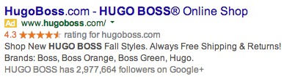
Google Seller Ratings
SEM
Reflect customers' buying experience with these businesses, as opposed to particular products
Customer-submitted ratings information about sellers next to their AdWords ads on Google search result pages, Google Shopping and Google search partners
Benefits for Businesses | Benefits for Consumers
17% higher click through rate on SEM (source: Google Blog) Powerful trust signal | Know how advertisers are rated by their own customers Greater confidence leading up to purchase
Notes:
Will Trustpilot reviews influence how high my website appears in Google Search Engine Results Pages (SERP)?
Google is the only one in control of what impacts search engine results. As a result, Trustpilot can't tell or promise you anything about how this link will impact your Search Engine Results Pages (SERP).
Top
Which countries are currently covered by Google Seller Rating Extensions?
At this time, Google has chosen to make Seller Ratings Extensions available for Google.de Google.co.uk, Google.com, Google.fr and Google.nl
Where may Trustpilot reviews be seen in Google?
The reviews your customers publish on Trustpilot may appear in 3 places:
Google’s normal organic search results
Google Shopping Merchant Reviews
Google AdWords Merchant Reviews

Slide 27
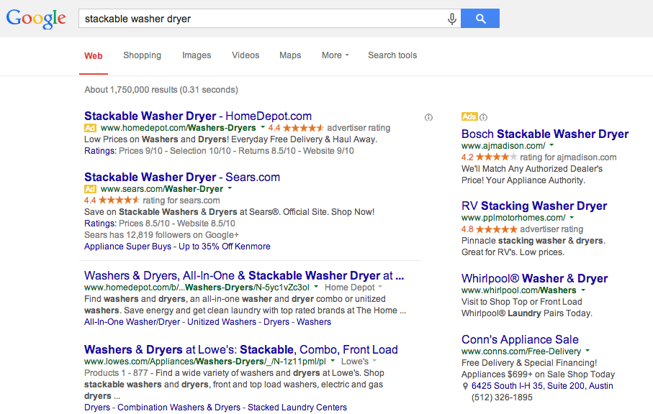
Seller Ratings in web search (Google & Search Partners)
SEM

Slide 28
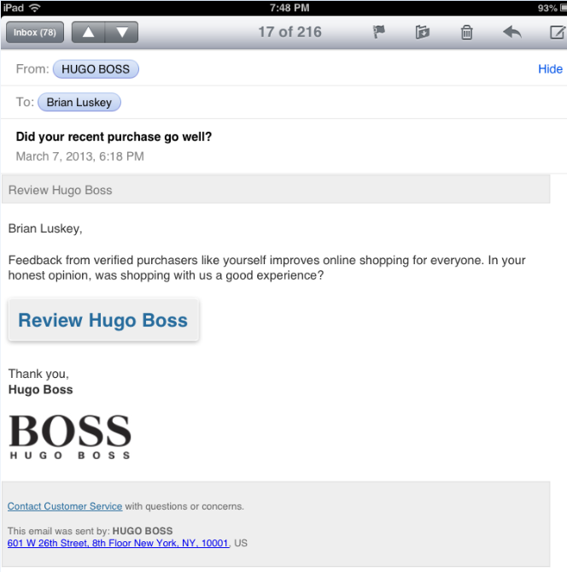
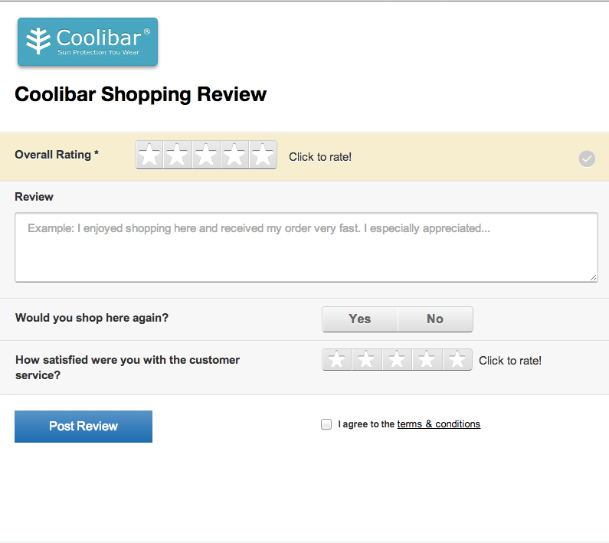
Google Seller Ratings – How We Do It
SEM
Simple process
Core feature of the Conversations platform
Leveraging existing purchase feed
Seller rating request email sent by Bazaarvoice
Submission form hosted by Bazaarvoice
Optimized for volume
Mobile optimised emails for higher click-through
Responsive submission form for higher volume
Availability
Google currently supports GSR on
Google.com, google.co.uk, google.de, google.fr, google.nl
Available for Conversations clients now

Slide 29
Google Seller Ratings – How We Do It
SEM
Simple process
Core feature of the Conversations platform
Leveraging existing purchase feed
Seller rating request email sent by Bazaarvoice
Submission form hosted by Bazaarvoice
Optimized for volume
Mobile optimised emails for higher click-through
Responsive submission form for higher volume
Availability
Google currently supports GSR on
Google.com, google.co.uk, google.de, google.fr, google.nl
Available for Conversations clients now
US PRR availability end of Feb. 2015; Availability for PRR in EMEA is TBD

Slide 30
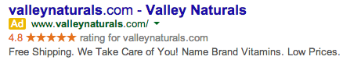
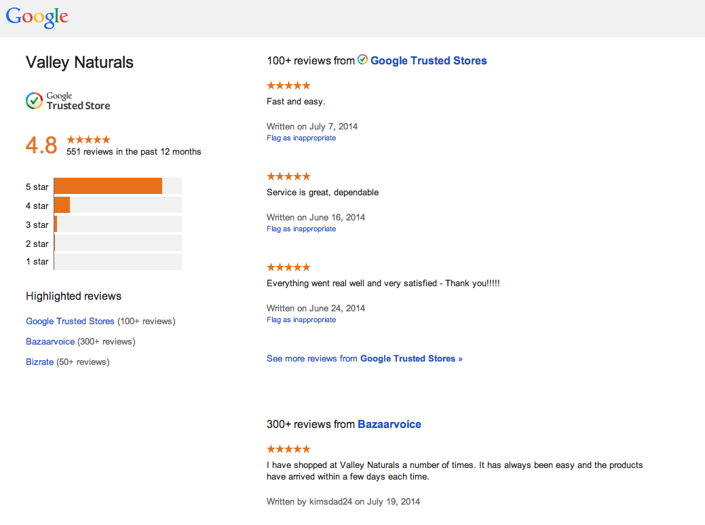
Google Seller Ratings – Examples
SEM

Slide 31
Google Local

Slide 32
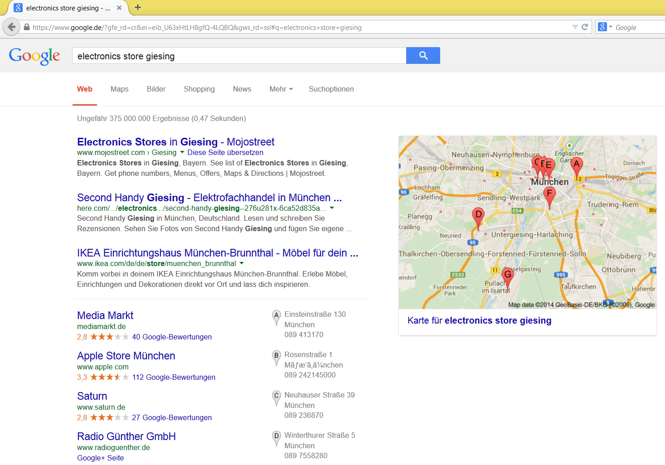
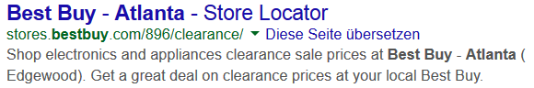
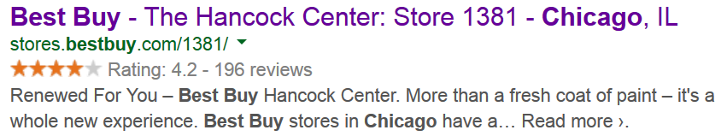
94% more likely to click on local search with stars
75% of consumers begin their local search in a search engine

Slide 33
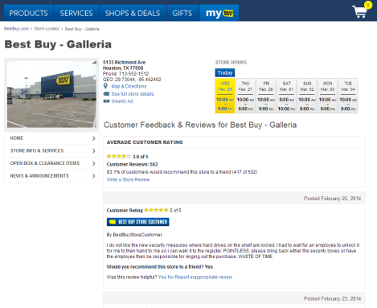
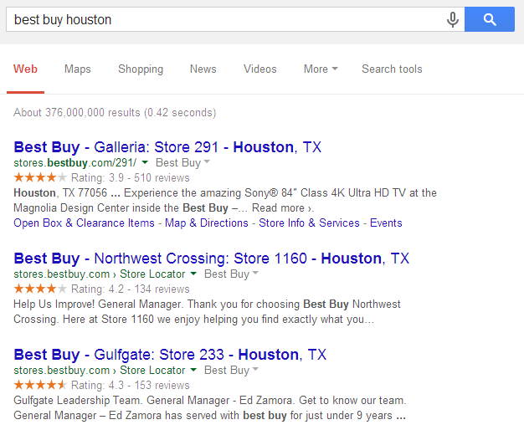
Best Buy 25% lift in search traffic + SEO, foot traffic

Slide 34
Google Shopping

Slide 35
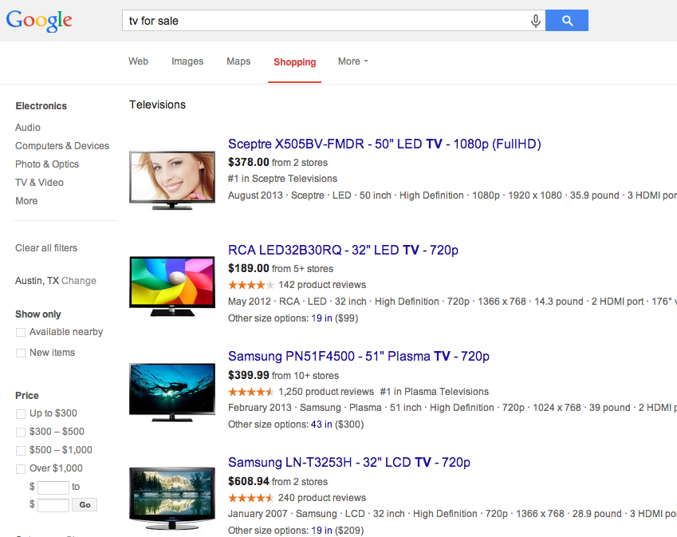
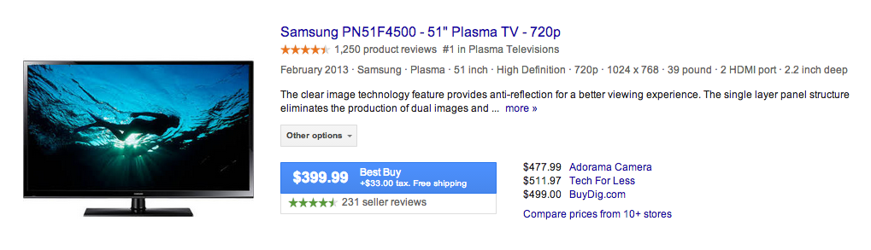
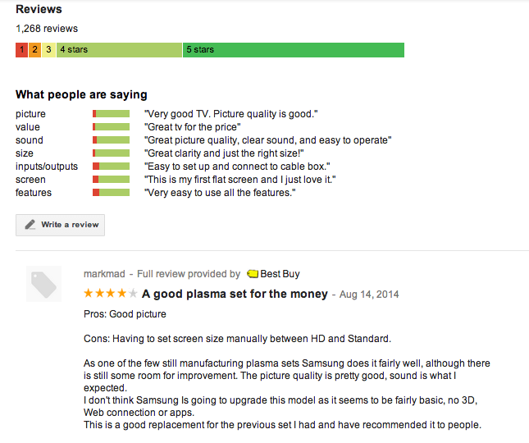
Google Shopping Reviews Directs Shopper Back to Retailer
Overview
Program funded by Google
Client must have e-commerce
Client signs up through Google Portal
Bazaarvoice send reviews to Google
Benefits
Increased Reach of UGC
Increase CTR→ Customer Acquisition
Availability
PRR and Conversations GA Now for US
Notes:
How to set up sharing of BV reviews for Google Shooping (as per the latest CS communication):
BV
BV CSD to open a support case.
Confirm client eligibility (>3000 reviews).
Notify Google to send the ToS to the Client.
Client:
Client to have a technical point of contact.
Client to accept Google Term of Services (ToS) sent directly by Google to the Client.

Slide 36
Google Product Listing Ads (PLAs)

Slide 37
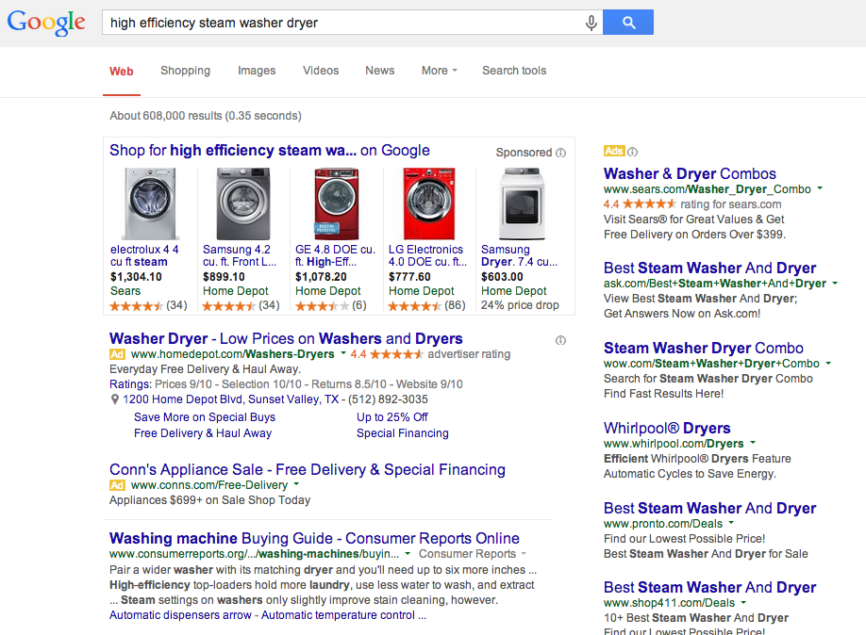
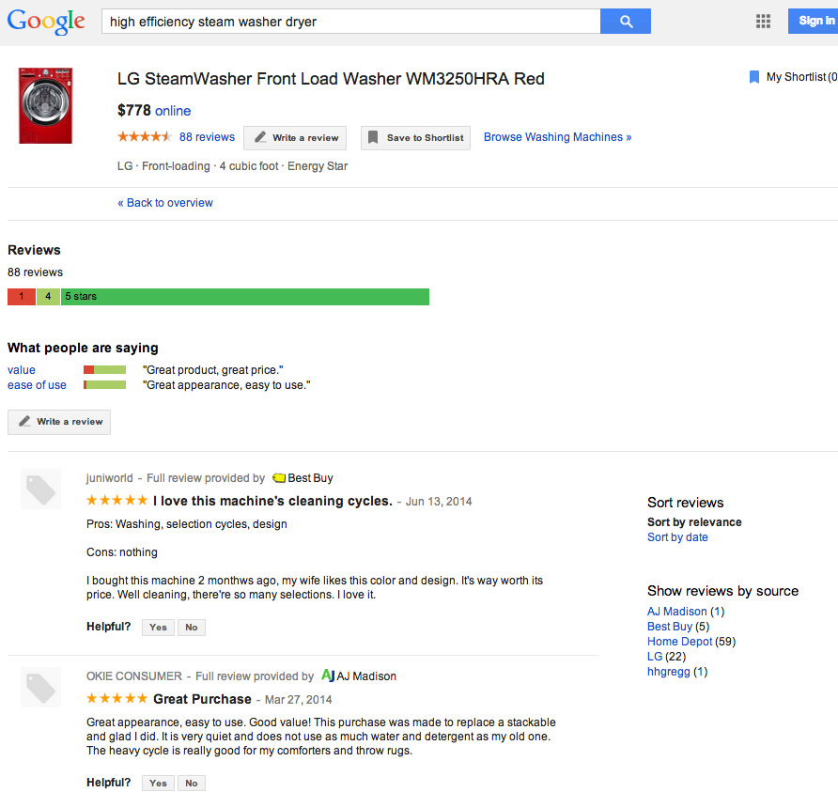
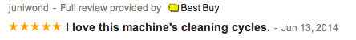
Google PLA – Display
SEM
Notes:
Note that while this is an “open program” from Google (meaning non-bazaarvoice clients can submit content), the majority of the reviews for many products come from Bazaarvoice clients. In this example, 84 of the 86 reviews are from BV clients (Home Depot, LG and Best Buy).

Slide 38
Google Product Listing Ads
SEM
Overview
Provides ratings summary and detailed reviews into PLAs (Google overview)
Client signs up via Google portal
Uses same BV feed as Shopping
Aggregates reviews from variety of sources
Only shows if client pays for sponsored ad (just like GSR only show up if client pays for Adwords ad)
Benefits
Improves click through rate; BV study suggests 11% lift in intent to click when PLAs featured rich snippet stars and ratings
Differentiate over the competition at selection time
Availability
As of July 2014, Google state they will roll out PLAs in Europe “over the next few months”

Slide 39
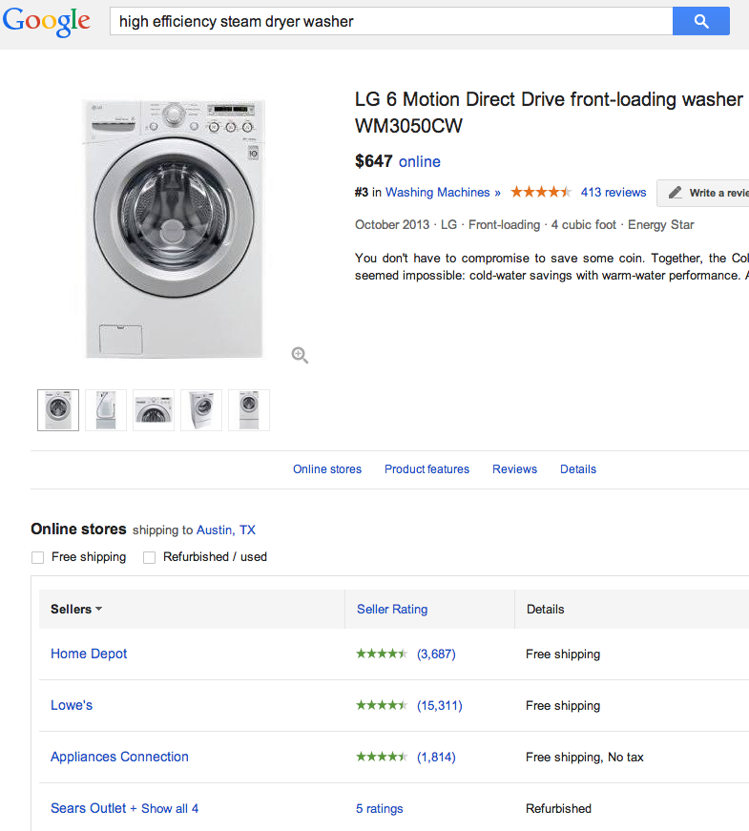
Seller AND Product Ratings in PLA
SEM
Product Ratings
Seller Ratings
Note: other providers also syndicate reviews into Google Seller Ratings, such as viewpoints, bizrate, trustpilot, epinions. All may have reviews for a given retailer in the Bazaarvoice network.

